Slide 1







Happy Poker dealer
P
Assignment 6
5/22 MON. 23:59
Notes:
https://www.ultraegaming.com/tw/blog/2017/11/01/%E5%BE%B7%E5%B7%9E%E6%92%B2%E5%85%8B%EF%BC%88texas-holdem-poker%EF%BC%89-%E7%8E%A9%E6%B3%95%E8%88%87%E8%A6%8F%E5%89%87/

Slide 2

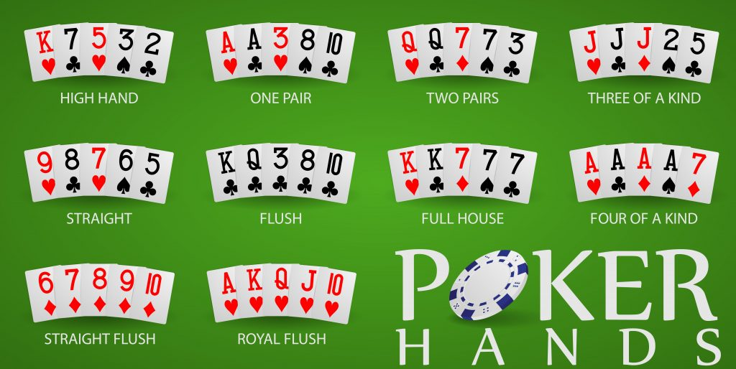
Poker dealer & Ranking machine
Notes:
https://gamblingnewsmagazine.com/poker-cheat-sheet/

Slide 3
Poker dealer & Ranking machine
P
基於鏈結串列建立一個可以儲存撲克牌(Card)、洗牌(shuffle)、 發牌(deal)的類別(DeckOfCards)。
並符合我們要求的輸出
建構一個類別(Hand)，該類別可以從DeckOfCards獲取一手牌 (五張)，然後並且判定該牌組所屬的類別
a pair, two pairs, three of a kind (e.g., three jacks),
four of a kind (e.g., four aces),
Flush (i.e., all five cards of the same suit),
straight (i.e., five cards of consecutive face values).
Straight flust
fullhouse (i.e., 3 aces and 2 kings)

Slide 4
Ranking
Four of a Kind: This refers to 4 cards of a similar kind. For instance, four Aces.
Full House: This refers to a combo of 3 of a kind with another pair. For instance, 3 aces and 2 kings.
Flush: This is a combination of 5 cars all of the same suit. They may or may not be in order. If you and your opponent both have a flush, whoever has the highest card wins.
Straight: This means 5 cards that are in sequence. For instance, 2-3-4-5-6.
Straight Flush
Three of a Kind: This refers to 3 cards of a similar kind. For instance, three kings.
Two Pair: Any set of 2 cards of a similar kind. A good example is a hand with two queens and two tens. It can be completed with any available high card.
Pair: This is simply 2 cards of a similar kind. For instance, two 4s.
N
Note

Slide 5
Poker dealer & Ranking machine
Notes:
https://gamblingnewsmagazine.com/poker-cheat-sheet/

Slide 6
ISSUES – 01 單張撲克牌
P
Class Card should provide:
Data members face and suit of type INT.
A constructor that receives two INTs representing the face and suit and uses them to initialize the data members.
Two static arrays of std::strings representing the faces and suits.
faceNames = { "Ace", "Deuce", "Three", "Four", "Five", "Six",
"Seven", "Eight", "Nine", "Ten", "Jack", "Queen", "King" };
suitNames = { "Hearts", "Diamonds", "Clubs", "Spades" };
A toString() function that returns the Card as a string in the form “face of suit.” You can use the + operator to concatenate strings.

Slide 7
ISSUES – 02 創建整疊撲克牌
P
Class DeckOfCards should provide:
A List of Cards named deck to store the Cards.
An integer currentCard representing the next card to deal.
A reset() function to reset currentCard number in deck
A default constructor that initializes the Cards in the deck.
This should be done for each of the 52 Cards in the deck.
A shuffle() function that shuffles the Cards in the deck.
A dealCard() function that returns the next Card object from the deck.
A moreCards() function that returns a bool value indicating whether there are more Cards to deal.

Slide 8
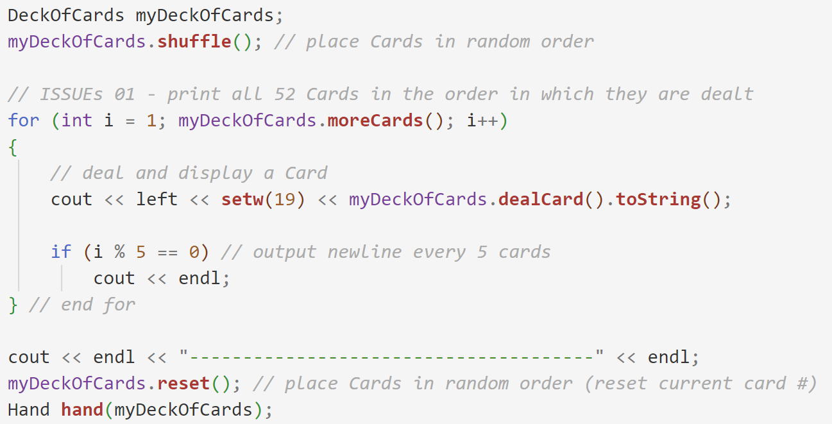
ISSUES – 02 創建整疊撲克牌
P
Class DeckOfCards should provide:
A List of Cards named deck to store the Cards.
An integer currentCard representing the next card to deal.
A reset() function to reset currentCard number in deck
A default constructor that initializes the Cards in the deck.
This should be done for each of the 52 Cards in the deck.
A shuffle() function that shuffles the Cards in the deck.
A dealCard() function that returns the next Card object from the deck. (正確版)
A moreCards() function that returns a bool value indicating whether there are more Cards to deal.
僅供參考，你可以根據實作改變 (比方說從這邊決定洗幾次牌)

Slide 9
ISSUES – 02-2 洗牌(連續切牌)
P
A shuffle(int) function that shuffles the Cards in the deck.
可以設計成輸入一個int來指定序號，未輸入則隨機
0
4
6
1
5
7
2
隨機抽一序號: 3
6
隨機抽一序號: 2
0
3
7
1
4
0
2
切牌一次
切牌一次
5
1
3
6
2
4
7
3
5
透過鏈結串鍊的優勢，在切牌過程中只需要修改指標即可
這邊預設是洗52次

Slide 10
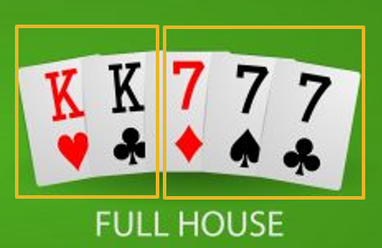
ISSUES – 03 儲存/判定一手牌
P
Class Hand should provide:
A constructor Hand( DeckOfCards &deck ) that initializes the Hand and draw 5 cards from a deck object.
operator<<, print() display contents of hand to standard output stream
takeAgain(DeckOfCards &deck) drop all cards and takes 5 cards from Deck again.
個別評估手牌: bool pair(), twoPair(), threeOfAKind(), fourOfAKind(), flush(), fullHouse(), straight() to determine whether the hand contains
也就是說可以個別檢驗不同類別的組合是否存在，共七種
注意 一個牌組可以符合多種條件，如 fullHouse 同時也滿足pair, threeOfAKind
輸出手牌最後符合的組合: string type()
直接輸出牌組的資訊 (共八種，包含straight flush)
(DeckOfCards中應該需要其他函式協助一次移除五張牌)

Slide 11
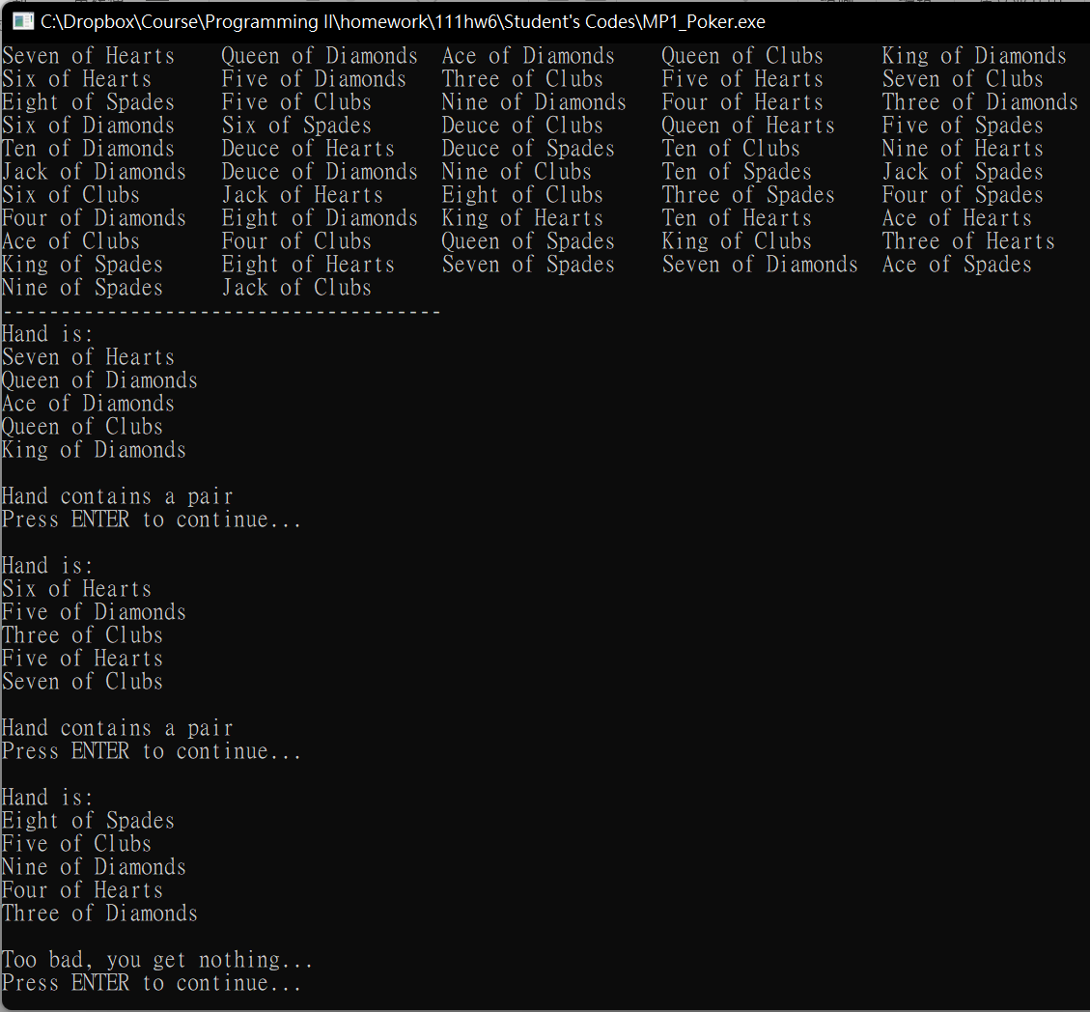
Console output
印出所有牌
抽一組牌
呈現符合的牌組中價值最高的
按Enter繼續抽，抽到不夠抽為止
找不到符合的牌組時的回覆

Slide 12
Poker dealer & Ranking machine
Notes:
https://gamblingnewsmagazine.com/poker-cheat-sheet/

Slide 13
Notes / Requirement
P
務必使用鏈結串列打造 List<T>，並使用私有繼承的方式來打造DeckOfCards (請採用課本上使用template來設計)
使用時可以是: DeckOfCards <Card> myDC; (課本寫法)
也可以是: DeckOfCards myDC; (繼承自List<Card>)
主程式一開始會隨機排序52張牌，每次按Enter依序抽5張，最後可以抽10次，共可抽出50張
牌堆被抽完後會觸發 exception，請在main()中捕捉並在觸發時印出提示文字(自行決定內容) 重新產生牌堆並繼續抽牌工作。
(需要自己創造一個例外物件，繼承自現有例外class)
BONUS: 在class Hand中實作 operator> < == != 來比較兩牌組是否相同以及誰大誰小 (>與< 佔15分、 ==與!=佔5分)
Notes:
加分項目，修改主程式讓他抽兩副手牌，並且實作一個函式比較之。

Slide 14
Review
P
採用template實作List資料結構 (可直接延伸自課本的版本)
撰寫Card, DeckOfCards, Hand等class
應該自行撰寫driver program，用來測試洗牌、發牌、牌面判斷等工作，並呈現指定的輸出。
若是有實現Bonus，請務必撰寫說明
*附帶的main_hw6.cpp僅供參考 (包含怎麼捕捉enter等寫法)

Slide 15
Submit your codes to Portal
S
Please use List, Card, Hand, DeckOfCards as your file class/filenames. And s1234567_hw6.cpp
Replace s1234567 by your own student ID.
And upload ONLY these codes.
Attach a s1234567_hw6.xls (scoring)
Please ZIP them with your student ID, s1234567_111hw6.zip
If you try to upload another files (for example *.sln or others), you get 0 point.
Make sure you have completed the assignment and Do it ON YOUR OWN and ON TIME.
Notes:
別忘了上傳你的main function!!!

